Slide 1
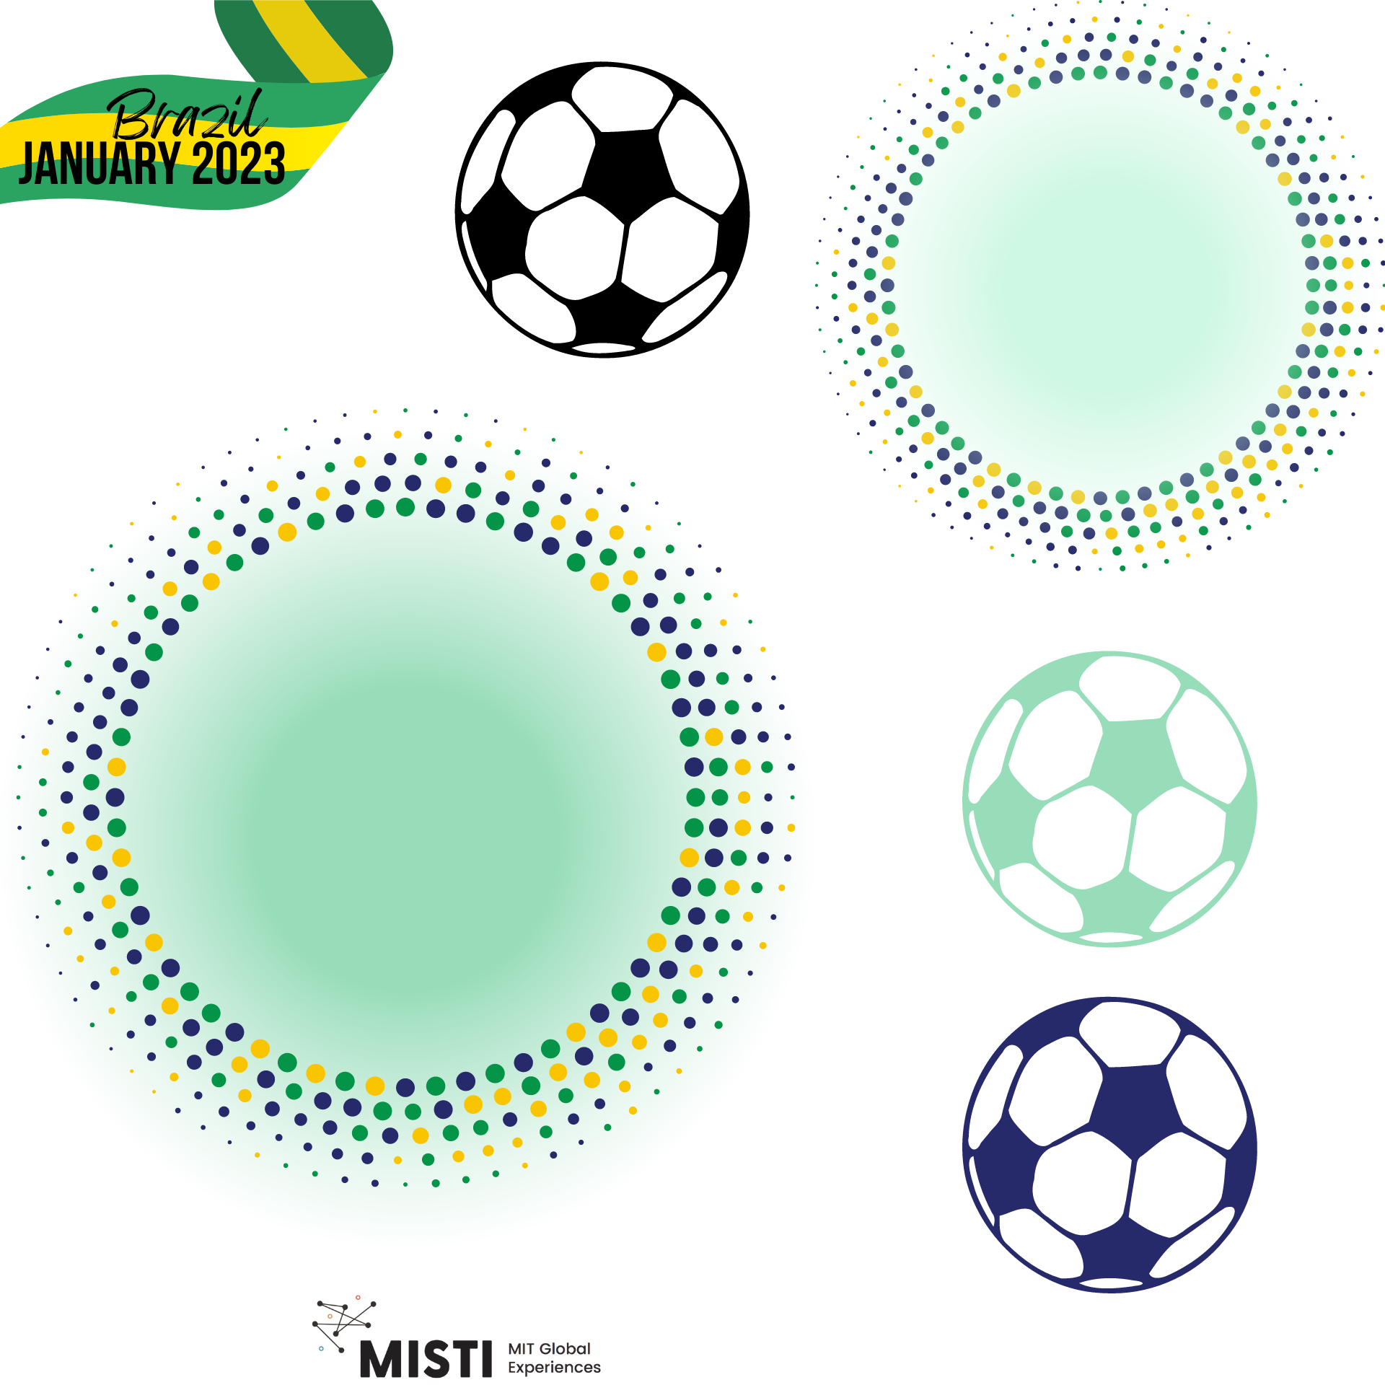
Materials in Biomedical Applications

Slide 2
How are materials used in medicine?
Medical Implants - artifical joints, heart valves
Image of artificial hip ball joint and artificial heart valve

Slide 3
How are materials used in medicine?
Medical Implants - artifical joints, heart valves
Methods for promoting healing - sutures, staples, dissolvable dressings
Images of sutures, staples, and other wound closing approaches

Slide 4
How are materials used in medicine?
Medical Implants - artifical joints, heart valves
Methods for promoting healing - sutures, staples, dissolvable dressings
Regenerated tissues - lab grown organs and 3D printed tissue
Image of 3D printed tissue set up

Slide 5
How are materials used in medicine?
Medical Implants - artifical joints, heart valves
Methods for promoting healing - sutures, staples, dissolvable dressings
Regenerated tissues - lab grown organs
Molecular Probes and Nanoparticles - imaging and targeted therapy
Image of fluorescent imaging of cancer cells under various treatment regimens

Slide 6
How are materials used in medicine?
Medical Implants - artifical joints, heart valves
Methods for promoting healing - sutures, staples, dissolvable dressings
Regenerated tissues - lab grown organs
Molecular Probes and Nanoparticles - imaging and targeted therapy
Biosensors - blood glucose monitors
Image of blood glucose monitor/test strip

Slide 7
How are materials used in medicine?
Medical Implants - artifical joints, heart valves
Methods for promoting healing - sutures, staples, dissolvable dressings
Regenerated tissues - lab grown organs
Molecular Probes and Nanoparticles - imaging and targeted therapy
Biosensors - blood glucose monitors
Drug Delivery Systems - Responsible for delivering the medicine to a specific place at a specific time
Image of drug release in body

Slide 8
What kinds of materials are used in the body?
Summary of prior uses with corresponding pictures

Slide 9
What kinds of materials are used in the body?
Image of dental implant with metal base, or screws used in surgery
Image of knee replacement
Image of quick-seal liquid bandage
Metais
Composites
Polymers

Slide 10
Do que esses materiais são feitos?
Polymers
Images of your favorite bio polymers, natural or synthetic
Natural materials | Synthetic materials
Polysaccharides Cellulose Glycolipids Proteoglycans Proteins and peptides | Poly (diethyl acrylamide) Poly (ethylene glycol) Polyvinyl acetate PLA

Slide 11
What characteristics do you think polymers need to have to be used as materials in medical applications?

Slide 12
Necessary characteristics:
Biodegradable
Bio-absorbed
Non-toxic
Anti-microbial properties
Image of biodegradable polymer at various time points during degradation

Slide 13
Sources
https://www.nibib.nih.gov/science-education/science-topics/biomaterials#:~:text=Metals%2C%20ceramics%2C%20plastic%2C%20glass,in%20biomedical%20products%20and%20devices.
https://www.google.com/url?sa=i&url=https%3A%2F%2Forthoinfo.aaos.org%2Fen%2Ftreatment%2Ftotal-joint-replacement%2F&psig=AOvVaw04_Ou52Rtp-zdJTKt43hob&ust=1704661045949000&source=images&cd=vfe&opi=89978449&ved=0CBMQjRxqFwoTCLCf78vTyYMDFQAAAAAdAAAAABAD
https://nsf-gov-resources.nsf.gov/styles/news_hero_mobile_600x352_/s3/news/artificial_valve5_f.jpg?VersionId=vDgxKpEbQ8OInVBu3BlUDzjsZp5kDMLX&itok=o2DAZiHL
https://www.google.com/url?sa=i&url=http%3A%2F%2Fwww.surfi.mtu.edu%2F2015%2F07%2F15%2Freview-on-medical-sutures%2F&psig=AOvVaw1sSBcxX5oe6l4SJNoazlu2&ust=1704667673431000&source=images&cd=vfe&opi=89978449&ved=0CBIQjRxqFwoTCMDv7o7syYMDFQAAAAAdAAAAABAD
https://www.drugtargetreview.com/news/110266/3d-bioprinting-artificial-organs-could-become-quicker-and-easier/
https://www.google.com/url?sa=i&url=https%3A%2F%2Fen.wikipedia.org%2Fwiki%2FBlood_glucose_monitoring&psig=AOvVaw2FhdsLLVjDeorEWjOnHZQD&ust=1704684436721000&source=images&cd=vfe&opi=89978449&ved=0CBUQ3YkBahcKEwj4op7Vq8qDAxUAAAAAHQAAAAAQAw
https://www.google.com/url?sa=i&url=https%3A%2F%2Fwww.europeanpharmaceuticalreview.com%2Fnews%2F155164%2Fnovel-implantable-polymer-could-improve-controlled-release-of-drugs%2F&psig=AOvVaw3DP4SUbwc2aLjJBR3-9XNt&ust=1704684542791000&source=images&cd=vfe&opi=89978449&ved=0CBUQ3YkBahcKEwiIhIz4qsqDAxUAAAAAHQAAAAAQAw

